Slide 1
VOTE HUB: An Online Election System
FINAL YEAR PROJECT
BATCH 2016-2020

Slide 2


SUPERVISED BY: Dr. Atif Saeed
Group Members
MUHAMMAD RABBI
FA16-BCS-314
MUHAMMAD ALI
FA16-BCS-295

Slide 3
Introduction
VOTE-HUB is a Web based Online Voting Tool & Election System.
VOTE-HUB is a platform where organizations and users manage the election system according to their own requirements.
Voter can cast vote by only one click after logging into the system by inserting their valid credentials.
Vote Hub is being designed in such a way that high security techniques are implemented in it to ensure security.
Two factors authentication is one of the security features.
Paper polling is a waste of valuable resources like time, paper and money.
Traditional election system takes a lot of effort of the organizer to manage the election and counting vote.
The people/employees who are out of the station due to any reason can cast votes manually availing this online voting system.
Ensuring that no chance of rigging will occur during elections.

Slide 4
Why this Idea ?
We chose VOTE-HUB: An Online Election System to provide a paper free environment for conducting elections, which is more SECURE , FAST and RELIABLE.
Our goal is to make this trend also applicable in Organizations of Pakistan so that people can ease them self with technology.
Organization’s can ease them self with the savage of valuable resources like time, money, efforts of managing the elections and counting the votes.
Rigging is one of the major issues of paper poling system so VOTE-HUB is designed in such a way that high security features are being implemented in it to avoid rigging.
VOTE-HUB is a best choice for Origination’s overseas voters which are not physically available at the time of election.

Slide 5
WHO IT’S FOR:
Professional and Other Associations
Not-for-Profits (NGOs, Societies, Charities, Clubs)
College and University
High Schools
Unions
Political Parties
Other Organizations

Slide 6
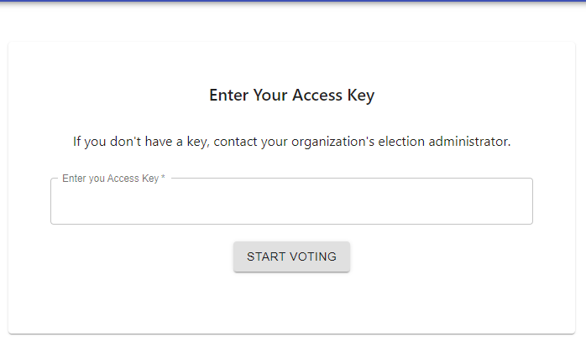
How the vote casting process works:
STEP 1:
User is provided with a Access key or Access link through E-mail from which he/she can get access to the ballots to submit vote .
Once the user has casted the vote the link gets expired and gets user logout from the ballot section.

Slide 7
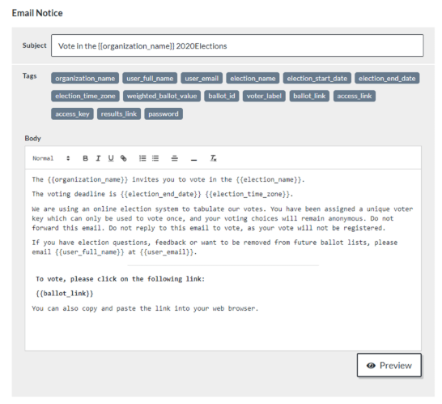
Step 2:
An access key generated by the system is benign sent to the user via E-mail in the following format.
User clicks on the link provided in the E-mail or simply copy the access key to get access to the ballots.

Slide 8
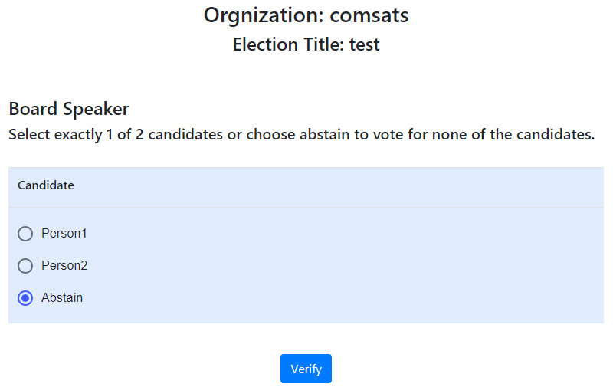
STEP 3:
After all the authentications user is directed towards the ballots section where he/she can select their favorite choice anonymously .
One vote at a time. No double casting of vote.
After confirmation link gets expired and user will not be able to log in again.

Slide 9
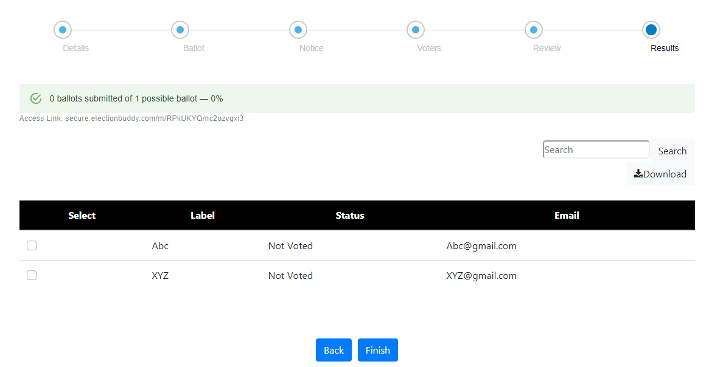
Results:
Results are being showed to the admin before or after the end of the election in the result bar.
Progress of the election is being showed in the progress bar how many candidates have voted.

Slide 10
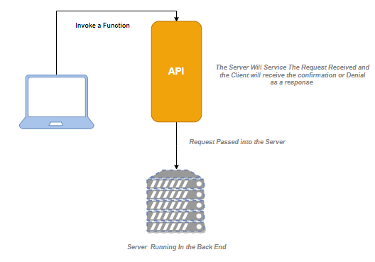
Software Arthitecture:

Slide 11
Software Development LifeCycle
Hybrid Model
We are using hybrid model which is the combination of prototype model and Incremental model. Hybrid model because in this way the requirements are broken down into multiple smaller standalone modules and the replications of these modules are implemented so that we can see the product results at early life cycle stage.
Why Hybrid Model?
It will generate working system in much less time during the SDLC.
Requirements will be divided into independent standalone modules.
It will be easier to test and debug in smaller iterations.
Those smaller modules will be implemented so that there will be less risk of errors.
Errors can be easily detected and removed with smaller sections.

Slide 12
Tools & Technologies:
MERN
MERN stack is being used in the development of this Web Application
React (also known as React.js or ReactJS) is a JavaScript library for building user interfaces.
Node.js is an open-source, cross-platform, JavaScript runtime environment that executes JavaScript code outside of a web browser.
MongoDB is a cross-platform document-oriented database program. Classified as a NoSQL database program. MongoDB uses JSON-like documents with schema.
Express.js, or simply Express, is a web application framework for Node.js.
Postman
Visual Studio Code

Slide 13
Functionalities & Features
LOGIN
SIGN UP
E-MAIL AUTHENTICATION
DASHBOARD
CREATE NEW ELECTION
CUSTOMIZED BALLOT CREATION
SEND NOTIFICATIONS
VOTERS LIST INTREGATION
VOTER SECURITY
AUTOMATIC VOTE COUNTING
RESULTS, REPORTS and GRAPHS
ANONYMOUS VOTE CASTING
LOGOUT

